Slide 1
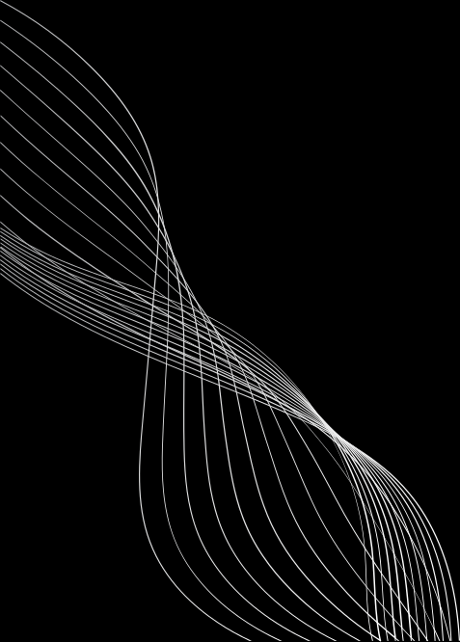


TEAM DETAILS
Project Title
AegisIQ – AI-Powered Infrastructure Decision Intelligence Platform
Tagline: Predict. Simulate. Protect
Team ID: H26DIS12
Team Leader: Sabariswaran M
Team Members:
Sabariswaran M
Sathyaraj K
Sridhar V
College Name Mangayarkarasi College of Engineering

Slide 2
PROBLEM STATEMENT & OBJECTIVES:
Problem Statement
•Modern IT infrastructures are highly interconnected.
•Small infrastructure changes can impact multiple services.
•Existing monitoring tools detect failures only after deployment.
•Organizations need a proactive solution to predict risks before deployment.
Objectives
•Predict deployment failures using AI.
•Analyze infrastructure dependencies.
•Simulate infrastructure changes using Digital Twin.
•Calculate Technical and Business Risk Scores.
•Recommend the safest deployment strategy.
•Reduce downtime and operational risks

Slide 3

EXISTING SOLUTIONS & IDENTIFIED GAPS
Existing Solutions
Grafana Datadog
Splunk Dynatrace
Gaps
•Reactive Monitoring
•No Digital Twin
•Limited Risk Analysis
•No AI Recommendations
Our Solution – AegisIQ
•AI Risk Prediction
•Digital Twin
•Risk Scoring
•Smart Deployment

Slide 4

SYSTEM DESIGN
HIGH-LEVEL WORKFLOW
Infrastructure Data
Data Collection
Dependency Analysis
Decision Twin Simulation
Explainable Decision Engine
Decision Confidence Score
Smart Deployment Strategy
What-If Scenario Comparison
Interactive Dashboard

Slide 5
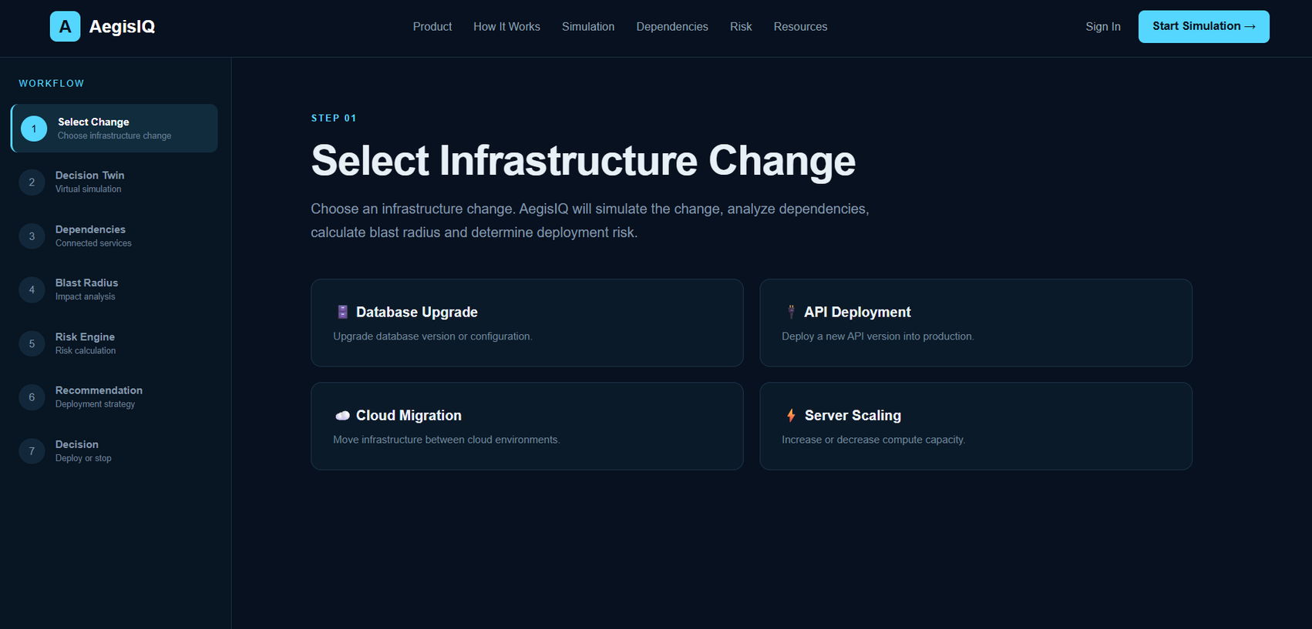
IMPLEMENTATION PROGRESS
Project UI Completed
Dashboard Developing

